Slide 1
Week-1
COSC 32001 Computer Vision
Noopa Jagadeesh
Date: 11 Jan 2024

Slide 2
Critical Path
Coming soon…..

Slide 3
Agenda
Introduction to COSC 32001

Slide 4
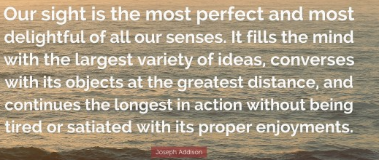
Introduction

Slide 5
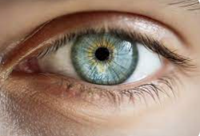
Human Vision System
Vision is our most powerful sense. It allows us to interact with the physical world without making any direct physical contact.
It turns out that roughly 60% of your brain is in one way or the other involved in the process of visual perception.
Vision is so powerful that we humans are able to navigate this very complex world that we live in seamlessly.
Computer vision is the enterprise of building machines that can see.
Given that the human visual system is so powerful, why even bother to build machines that can emulate it?
There are many chores we perform on a daily basis that we would rather have done by a machine so we can free up the time to devote to more rewarding activities. Examples of such chores might be tidying your home or driving to work.
Second, while our vision system is truly powerful, it tends to be more qualitative than quantitative. It is not particularly good at making precise measurements of things in the physical world.
Lastly, a computer vision system can be designed to surpass the capability of human vision and extract information about the world that we humans simply cannot perceive.

Slide 6
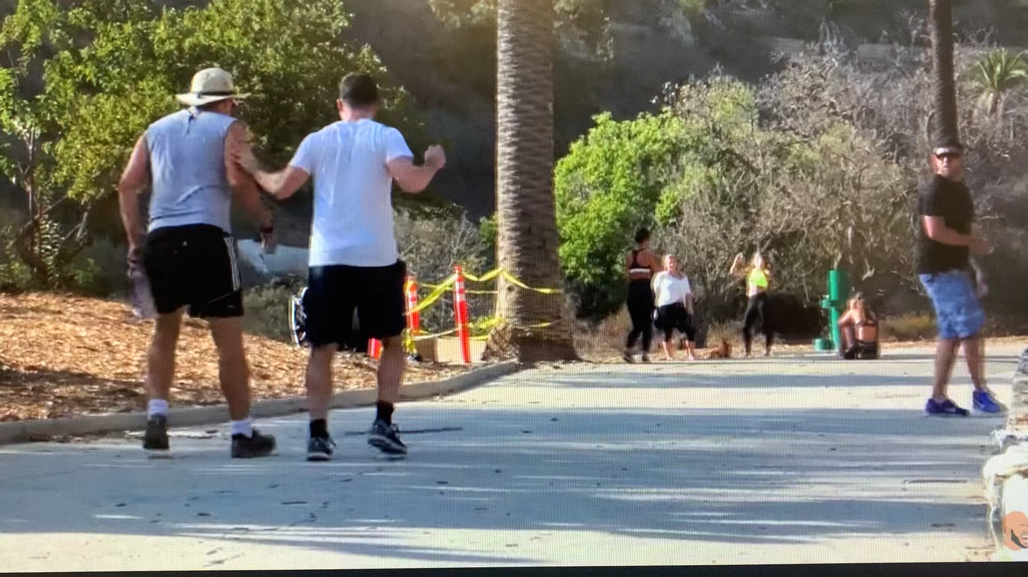
Human Vision System
Given that the human visual system is so powerful, why even bother to build machines that can emulate it?
Human vision is more fallible than we like to believe. We see, when you and I perceive something incorrectly, we do not have a voice in our head telling us we are wrong.
We see that what we see, and we believe it to be accurate.

Slide 7
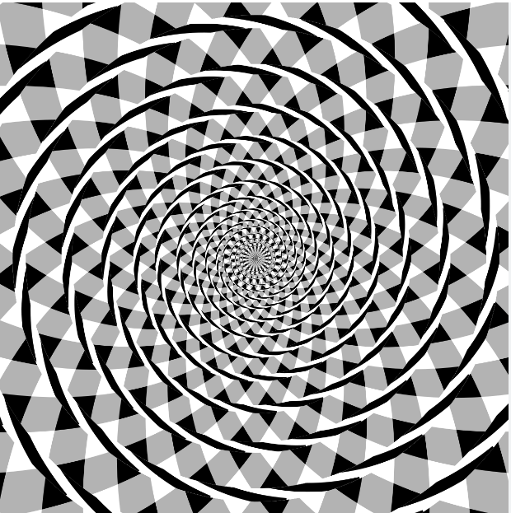
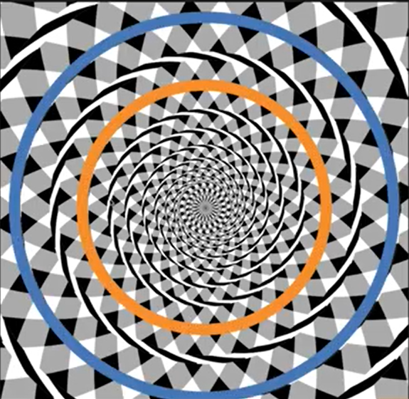
Optical Illusions
Fraser's spiral
We see a spiral emerging from the center.
But it turns out there is no spiral here.
If we follow one of these contours,
and go all the way around we find that we come back to exactly the same place.
In other words, this is actually a set of concentric circles.

Slide 8
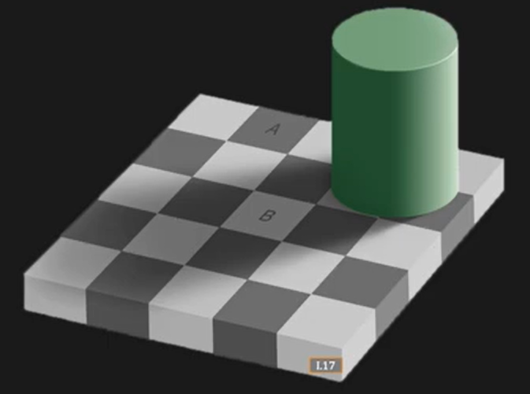
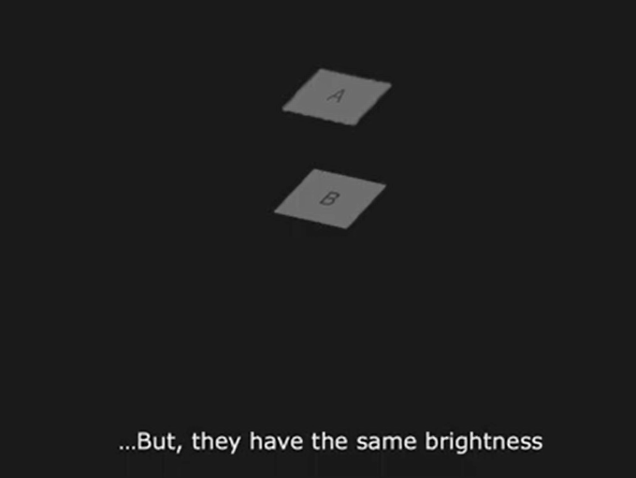

Optical Illusions
Checker shadow

Slide 9
Optical Illusions
Checker shadow
Well, it turns out that our visual system
is able to figure out in this case,
that the illumination is varying over the scene.
It's gradually varying.
It's able to detect this spatially varying illumination and use it to compensate for the brightness values in the image
itself, and therefore, able to figure out that patch A is made of darker material than patch B, although both of them actually have exactly the same brightness.

Slide 10
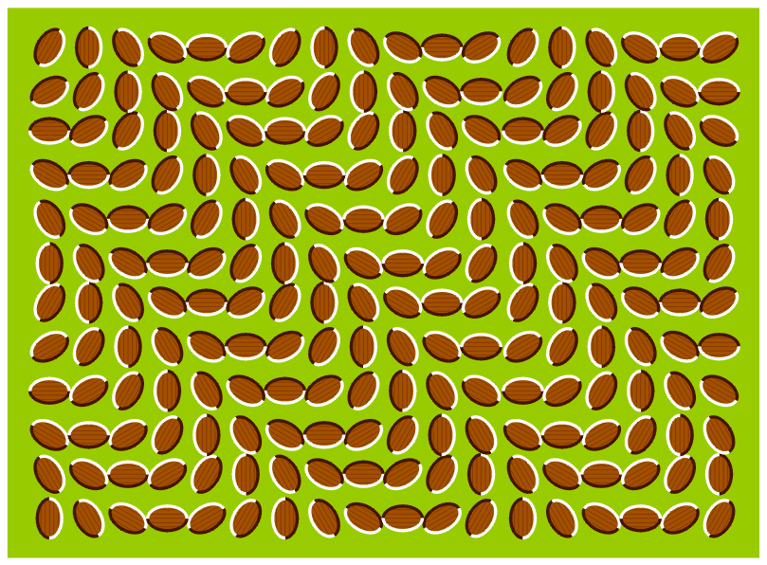
Optical Illusions
Donguri Wave
We can see motion.
But this is actually perceived motion without any motion.
This is a static photograph and not a video.
And there is forced perspective

Slide 11
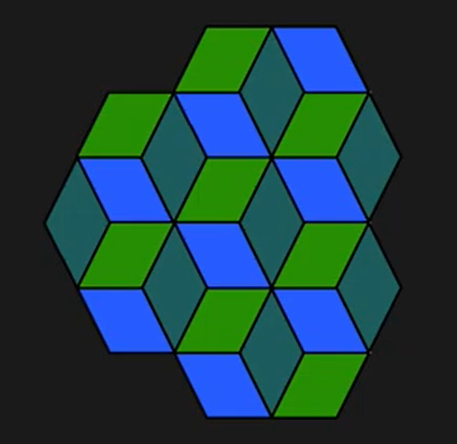

Visual Ambiguity
An ambiguity arises from the fact
that in vision, we have a three-dimensional world that's
being projected onto a two-dimensional image.
So you are, in some ways, dropping one dimension. And this creates some fundamental ambiguities.
In this particular case, if you look at a vertex, and if you stare at this vertex, you see that at times, it looks like a cube that is popping out and sometimes jutting in,
so concave or convex.
And depending on which interpretation your mind
latches on to, you either see six cubes or seven cubes.
And in fact, if you keep staring at it, this interpretation can flip over time.
Both are equally likely because it's an ambiguity.

Slide 12
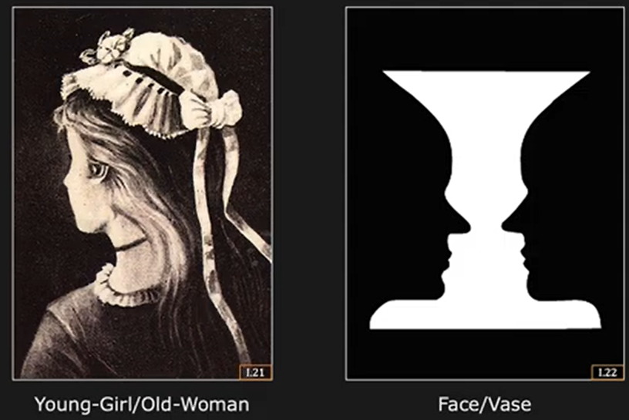
Visual Ambiguity

Slide 13


Seeing vs. Thinking
Here in the center, you see a white triangle.
In fact, this white triangle in the center
seems to be brighter than the white background.
And it seems to be jutting out a bit, that it's closer in depth than the rest of the scene.
But there is no triangle here.
There are actually three Pac-Man-like fragmented discs very carefully configured and aligned that give us the illusion of a white triangle.
Our brain is actually filling in this information.
It believes that there is a triangle.
This is the difference between seeing and thinking.

Slide 14
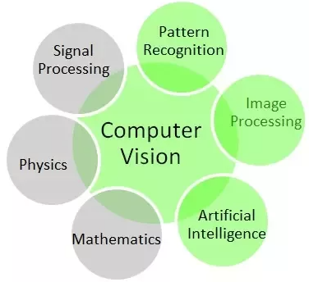
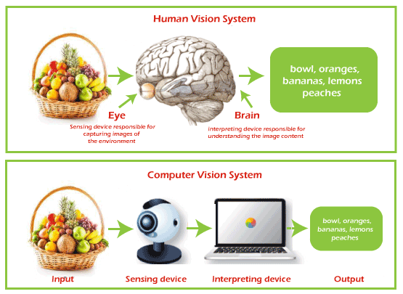
Computer Vision
Computer vision is a field of computer science that focuses on enabling computers to interpret and understand the visual world. This involves methods for acquiring, processing, analyzing, and understanding digital images, and extraction of high-dimensional data from the real world to produce numerical or symbolic information. The primary goal of computer vision is to enable computers to perform tasks that require human visual abilities.

Slide 15
Computer Vision
The goal of computer vision is to build machines that can see.
We will look at how images are formed and then
develop a variety of methods for recovering information
about the physical world from images.
Along the way, we will see several real-world applications
of vision.

Slide 16
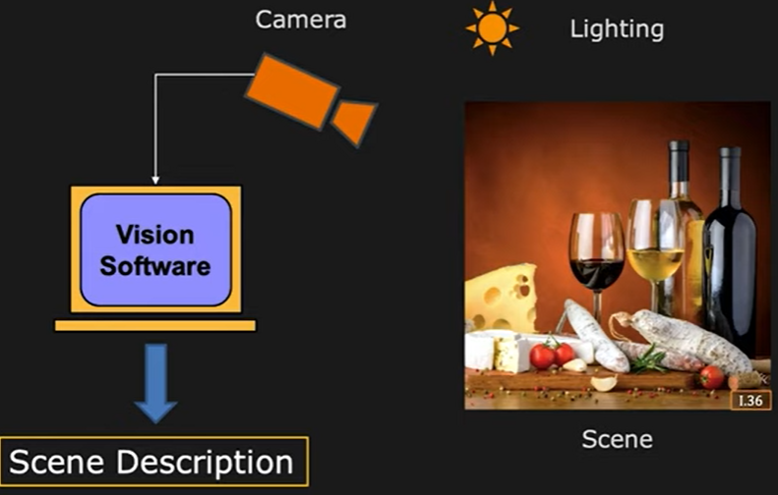
Basic Elements of Computer Vision System
The light from various light sources
falls in the scene and is scattered or reflected by the scene in many different directions.
And a small fraction of this light
is scattered in the direction of this
camera, which plays the
role of the human eye.
A three dimensional scene
The camera takes light from the three dimensional scene to produce a two dimensional image.
This image is passed on to a vision software. And the goal of this vision software is to come up with a symbolic description of the scene.
For example, it might be able to say that there are two wine
bottles, wine glasses. There's bread, cheese on the table.
The scene is lit by some form of lighting. It could be very simple outdoor lighting as in the case
of a single point light source, the sun,
or it could be more complex indoor lighting
with various types of lamps.
A more sophisticated vision system
may be able to tell you how fresh the bread is,
exactly what types of cheese are on the table, and perhaps even the vintage of the wine.
Without lighting, there is no vision.

Slide 17
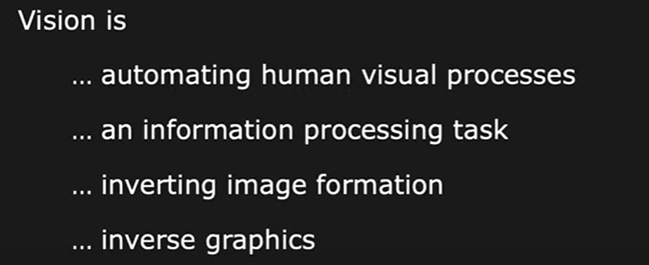
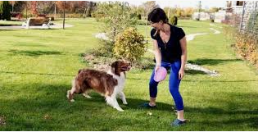
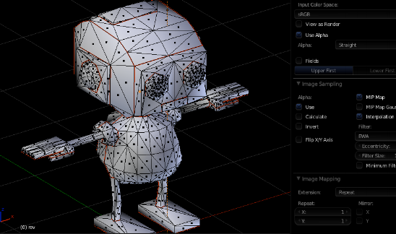
Definition of Computer Vision
-- David Maher
--Berthold Horn

Slide 18
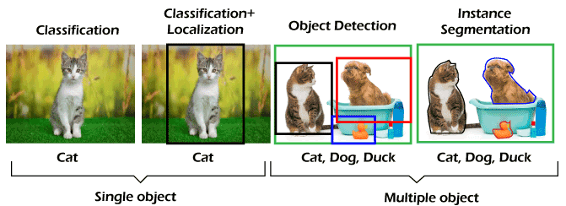
Task Associated with Computer Vision
Perception
Perception, refers to the process of interpreting and understanding the content of an image. In human cognition, it's about how our brain interprets what we see. In artificial systems, it's about how algorithms interpret image data to recognize patterns, objects, and scenes.
This involves pattern recognition, object detection and recognition, scene understanding, and even higher-level tasks like semantic segmentation and image captioning.
To enter this domain, you must deeply understand basic machine learning concepts such as neural networks, CNN, Recurrent Neural Networks, Generative adversarial neural networks, etc. And we use deep learning frameworks like TensorFlow, PyTorch, Keras etc.

Slide 19
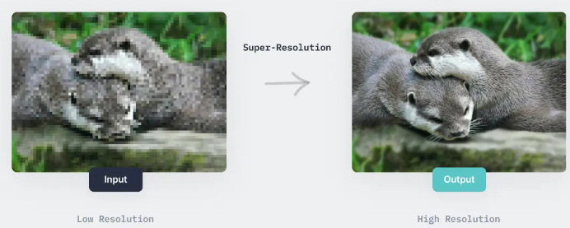
Task Associated with Computer Vision
Image Processing
Image processing involves techniques for performing operations on images to enhance them or extract useful information. It's a form of signal processing where the input is an image, like a photograph or video frame, and the output can be either an image or a set of characteristics or parameters related to the image.
The primary goal is to perform specific operations on an image to get an enhanced image or to extract some useful information from it. It's more about manipulating the image data to achieve desired results.

Slide 20
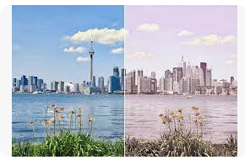
Task Associated with Computer Vision
Image Processing
It includes tasks like image enhancement (contrast adjustment, noise removal), image restoration, edge detection, image segmentation, and color processing.
Used in various fields such as medical imaging (MRI, CT scans), remote sensing, image sharpening and restoration, color correction, etc.
We use software like Adobe Photoshop for basic image processing, and more advanced tools like MATLAB, OpenCV for complex operations.
Color Correction

Slide 21
Image Processing

Slide 22
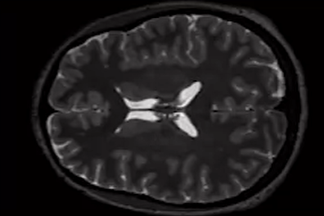
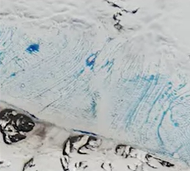
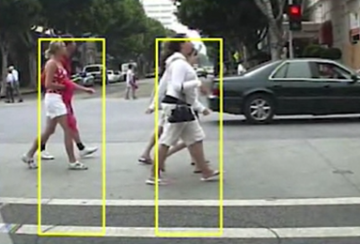
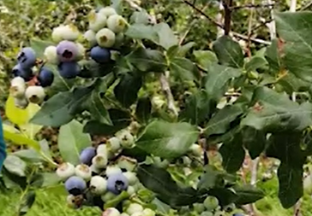
Image Processing
Extracting information from images is essential to a wide variety of applications, such as diagnosing medical conditions, studying the impact of climate change, designing autonomous systems, improving agriculture, etc.

Slide 23
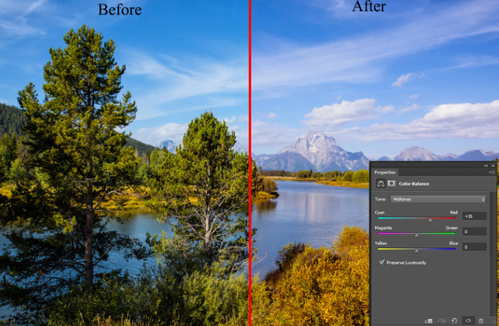
What we will Learn?
We will learn how to create common image adjustments

Slide 24
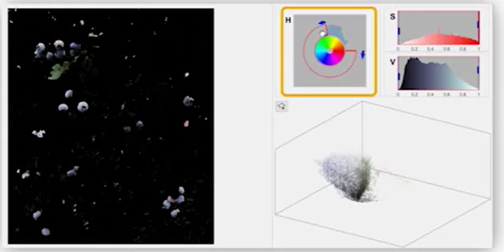
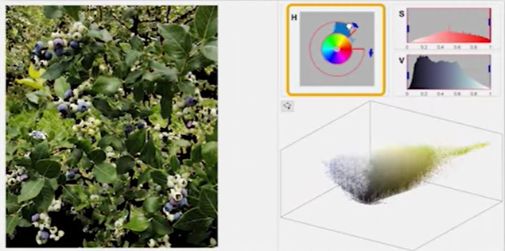
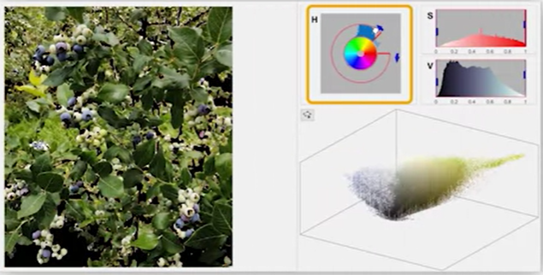
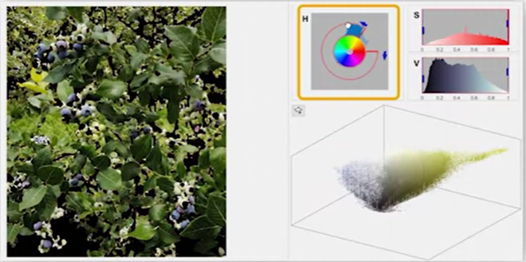
What we will Learn?
How to isolate regions of interest for further analysis.

Slide 25
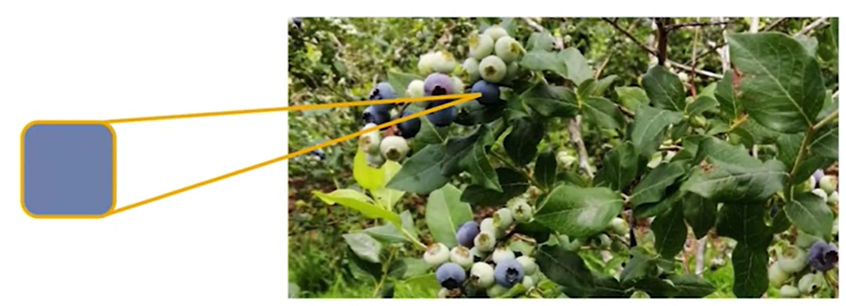
What we will Learn?
Isolating regions of interest for further analysis. Like using color information to identify right blueberries

Slide 26
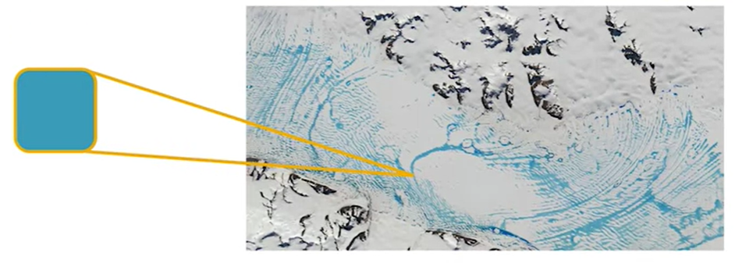
What we will Learn?
Isolating regions of interest for further analysis. Like calculating the amount of glacial melting from satellite images.

Slide 27
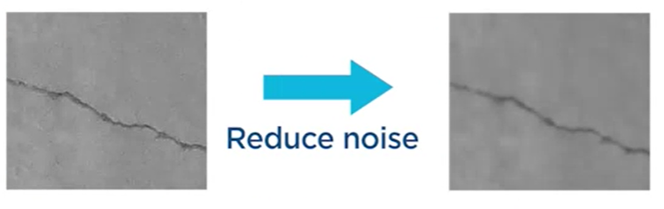
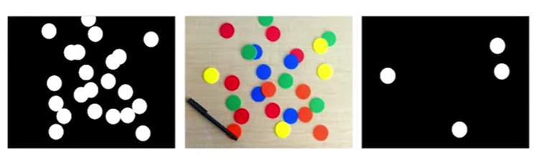
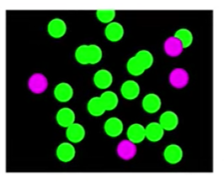
What we will Learn?
Common challenges to segmenting images. Like techniques to reduce noise and separate overlapping objects, ensuring that we isolate only the relevant information.

Slide 28
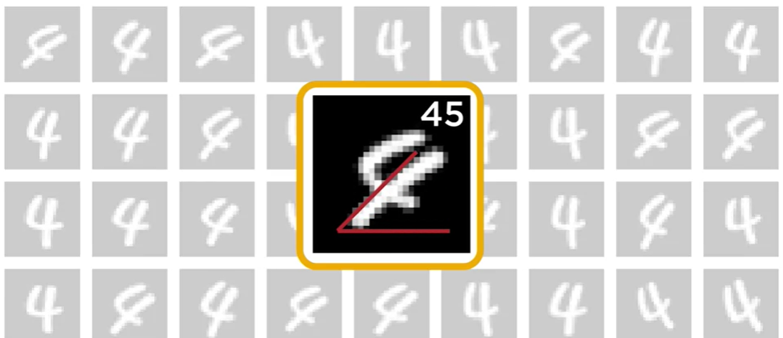
What we will Learn?
Analyzing the regions you find, like calculating properties, such area and orientation.

Slide 29
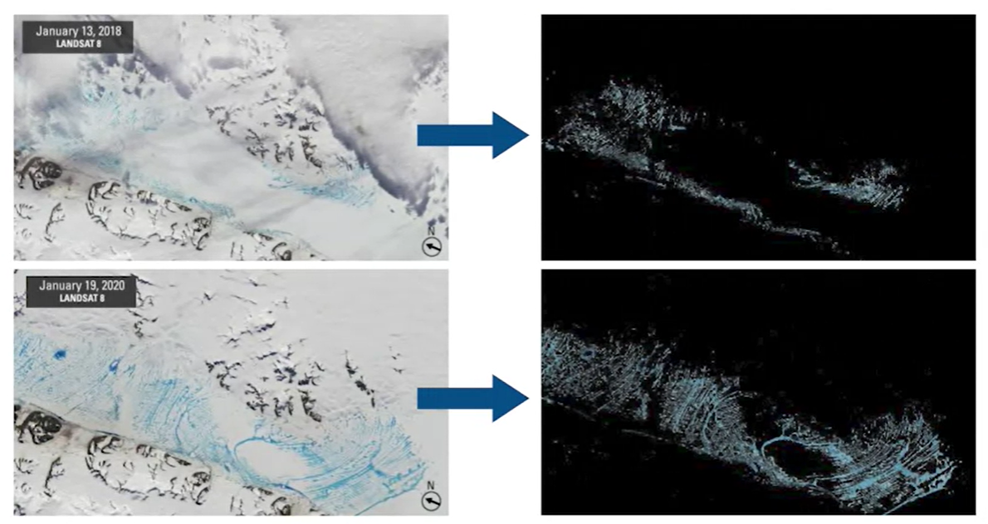
Final Outcome of the course
Isolate the blue melt water and calculate their areas, allowing us to estimate how the ice shelf is changing over time

Slide 30
Digital Image

Slide 31
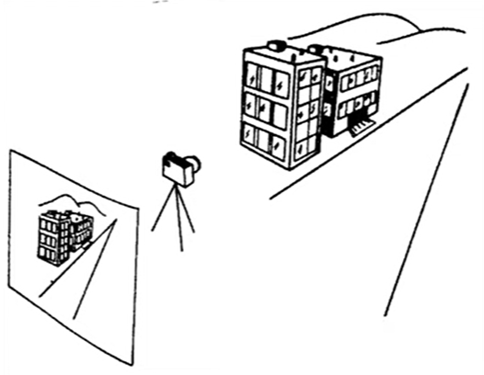
Digital Images
Vision Deals with Images.
An image is an array of pixels(picture element).
And each pixel in a image records information about a corresponding point in the scene.
If you look at consumer cameras, a pixel provides the brightness and color of the corresponding point in the scene.

Slide 32

Images Are Interesting
We get a sense of the three dimensional structure
of the scene, the landscape, the time of day, and even the weather.
And in fact, we can even get a sense
of the playful mood of the scene.
Maybe the sensation of what the girls may be feeling as the water strikes their head.
All of this in a fraction of a second

Slide 33
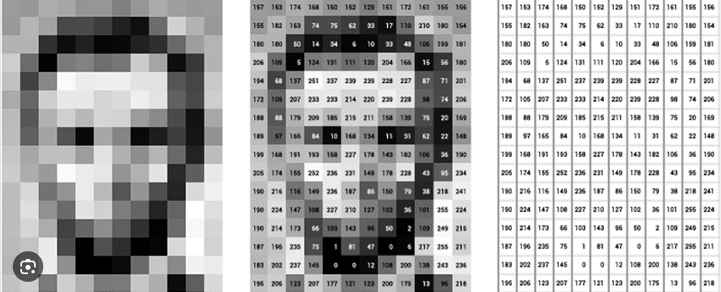
Digital Image
We have images, but its digital equivalent, is what we are interested. Which is nothing but an array of numbers.
And it is from this set of numbers that we seek to extract all the information

Slide 34
Topics Covered

Slide 35
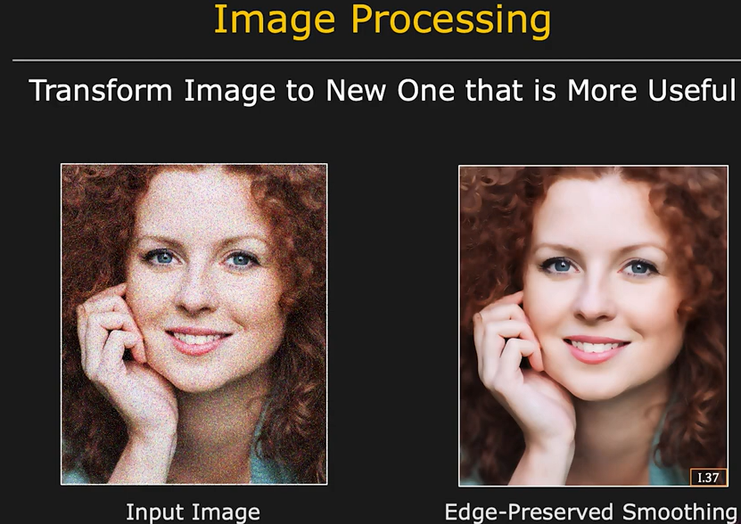
Image Processing

Slide 36
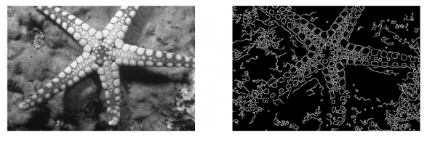
Feature Detection
The first features we're going to look at are edge detectors and corner detectors
Edge Detection
The Canny Edge Detection algorithm is a widely used edge detection algorithm in today’s image processing applications.

Slide 37
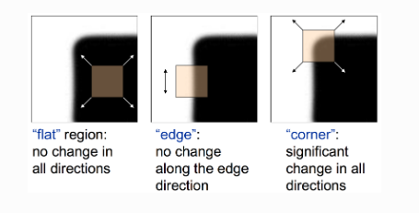
Feature Detection
The first features we're going to look at are edge detectors and corner detectors
A Harris Corner Point Detector can be used to find key points.

Slide 38
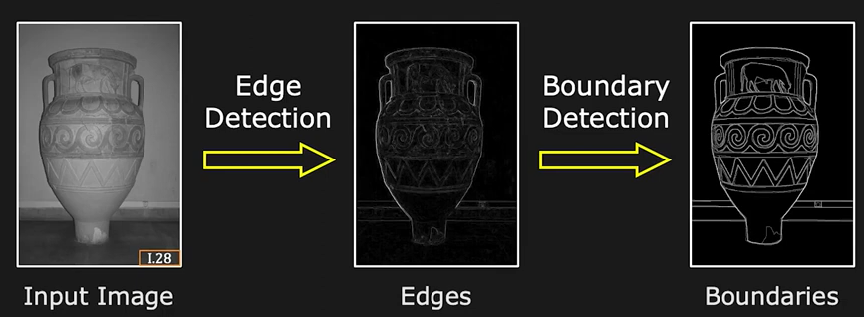
Boundaries from Edge Detection
Finding Continuous Lines from Edge Segments
We apply an edge detector to an image such as the one on the left here.
In the center we have, what we call,
an edge map, that gives the strength of the edge at each point.
And now we need to go from the edges
to boundaries such as the one shown here.
So we will have to develop algorithms for boundary detection.
When you and I take a look at this,
we can immediately figure out which
edges belong to the same boundaries or contours.
But that's because the brain is doing it for us. But, actually, this is just a set of edges

Slide 39
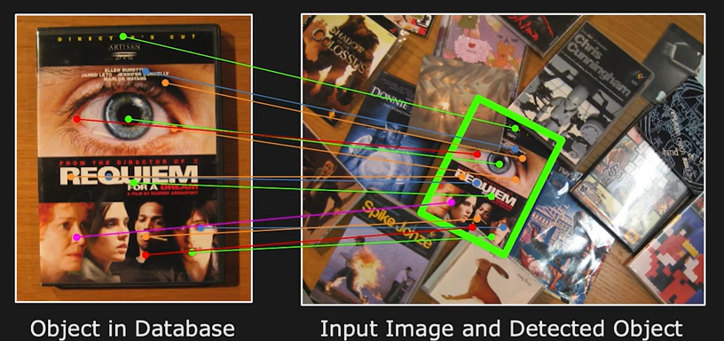
Feature Matching
2D Recognition using Features Matching using "Interesting Points"
A specific detector which is very powerful is the SIFT detector( Scale-invariant feature transform).
All the dots in the left, the colored dots, these
are SIFT features that have been detected by the algorithm.
And we can very robustly find these blobs, even when the object is translated or rotated or scaled. And that makes it really useful for recognition problems.
They don't seem to be attached to edges but actually to blobs or interesting areas in the image.
So, for instance, in the image on the right, we see the same object not only transformed geometrically, but also obstructed partially. And yet, we're able to match these features
and find the object very effectively, very robustly.
So we will look at SIFT features.

Slide 40
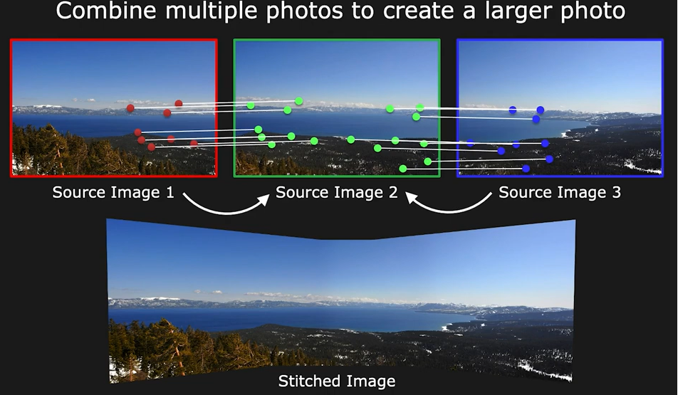
Image Alignment and Stitching
Combine multiple photos to create a larger photo
This is popular applications of feature detection.
These are overlapping images.
We apply feature detection to these images.
The features are identified.
And then from these three images, we are able to create a seamless panorama.
This is an algorithm that sits on most smartphones these days.

Slide 41
Disclaimer
Due to nature of the course, various materials have compiled from different open source resources with some moderation. I sincerely acknowledge their hard work and contribution

Slide 42


